Slide 1
Challenges
Mini challenge 6

Slide 2
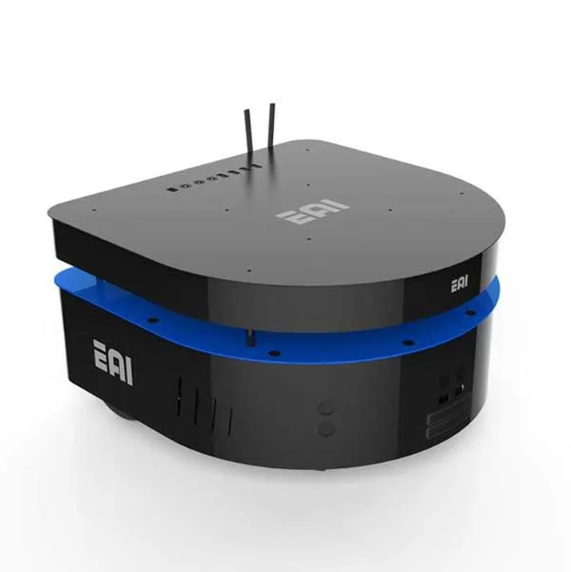
Mini challenge 6
This challenge is intended for the student to review the concepts introduced in this week.
Development of a kinematic simulator for the EAI DashGo B1 robotic platform using the kinematic model of a nonholonomic robot.

Slide 3
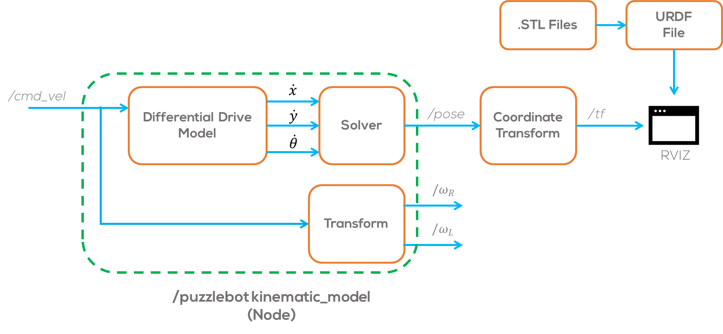
Mini challenge 6
This activity consists of creating a node that simulates a dynamical system.
Simulate a nonholonomic robot (e.g., EAI DashGo B1) using ROS.
The results of the simulation, must be visualised in RVIZ.
The visualisation must be a 3D robot on RVIZ.
Use the “.stl “ files provided by MCR2 to visualise the robot in RVIZ.

Slide 4
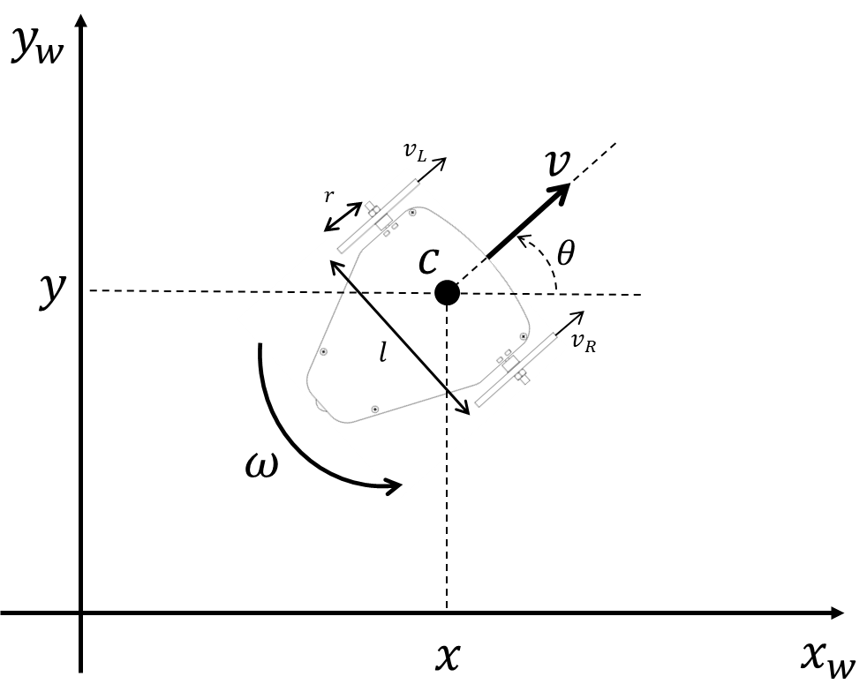
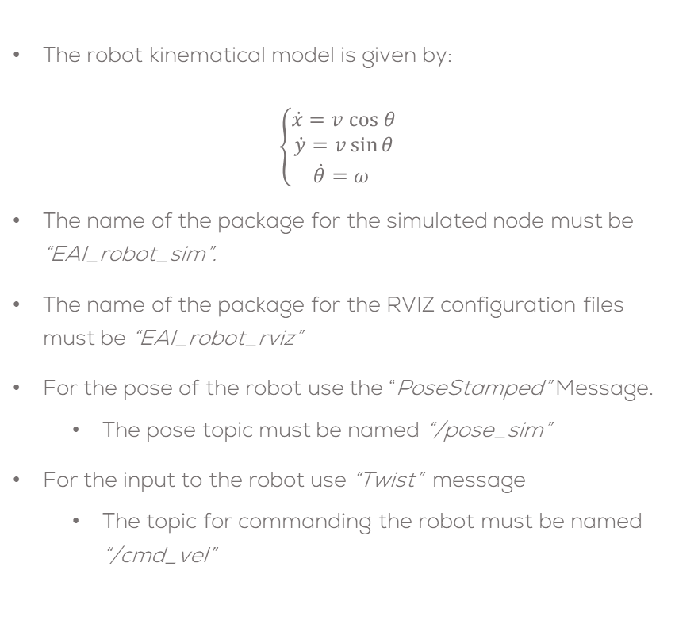
Mini challenge 6
The robot kinematical model is given by:
$$\left\{\begin{aligned}\dot{x}=v cos θ \\ \dot{y}=v\sin{θ} \\ \dot{θ}=ω \end{aligned}\right.$$
The name of the package for the simulated node must be “EAI_robot_sim”.
The name of the package for the RVIZ configuration files must be “EAI_robot_rviz”
For the pose of the robot use the “PoseStamped” Message.
The pose topic must be named “/pose_sim”
For the input to the robot use “Twist” message
The topic for commanding the robot must be named “/cmd_vel”

Slide 5
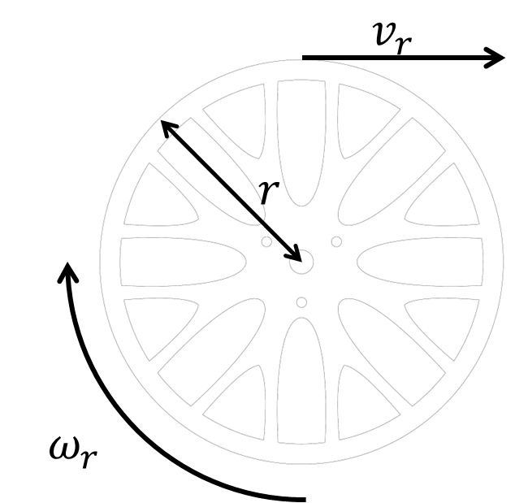
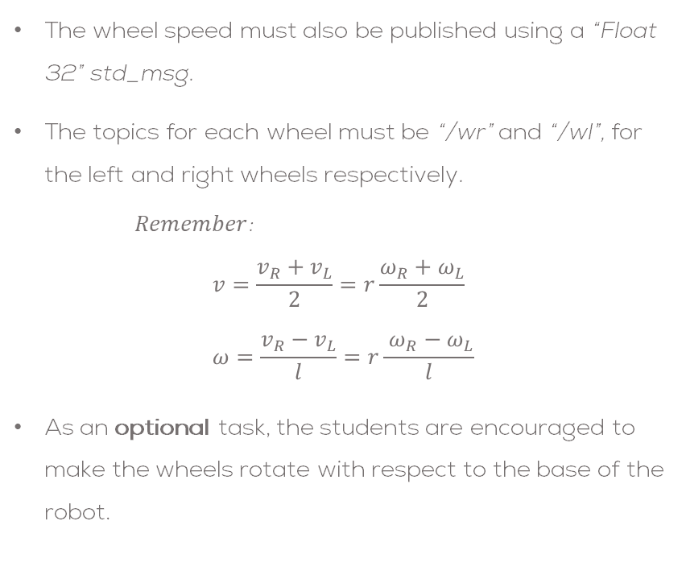
Mini challenge 6
The wheel speed must also be published using a “Float 32” std_msg.
The topics for each wheel must be “/wr” and “/wl”, for the left and right wheels respectively.
$Remember$:
$$v=\frac{v_{R}+v_{L}}{2}=r\frac{ω_{R}+ω_{L}}{2} \\ ω=\frac{v_{R}−v_{L}}{l}=r\frac{ ω_{R}−ω_{L}}{l}$$
As an optional task, the students are encouraged to make the wheels rotate with respect to the base of the robot.

Slide 6
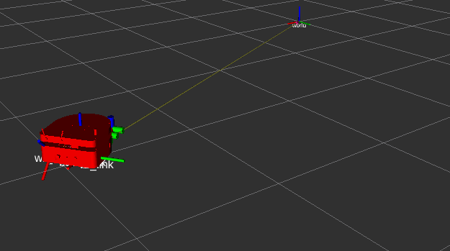
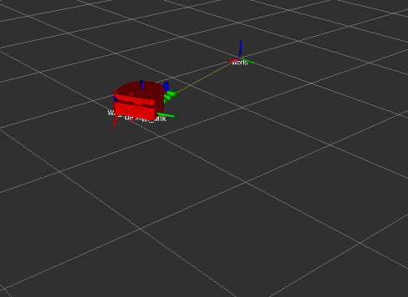
Mini challenge 1: Part 1
The student is allowed to use “tf” coordinate transforms or “URDF “ files for the simulation, or a combination of both.
The student must define the coordinate frames and transformations to be used.
The students must define the required launch files for this activity.
The simulation must be tested under different conditions, i.e., different speeds.
The students must define a correct sampling time for the simulation .
The students must solve the differential equations using numerical methods.
The usage of any library is strictly forbidden.
Expected results:

Slide 7
Rules
This is challenge not a class. The students are encouraged to research, improve tune explain their algorithms by themselves.
MCR2(Manchester Robotics) Reserves the right to answer a question if it is determined that the questions contains partially or totally an answer.
The students are welcomed to ask only about the theoretical aspect of the classed.
No remote control or any other form of human interaction with the simulator or ROS is allowed (except at the start when launching the files).
It is forbidden to use any other internet libraires with the exception of standard libraires or NumPy.
If in doubt about libraires please ask any teaching assistant.
Improvements to the algorithms are encouraged and may be used as long as the students provide the reasons and a detailed explanation on the improvements.
All the students must be respectful towards each other and abide by the previously defined rules.
Manchester robotics reserves the right to provide any form of grading. Grading and grading methodology are done by the professor in charge of the unit.

